Slide 1
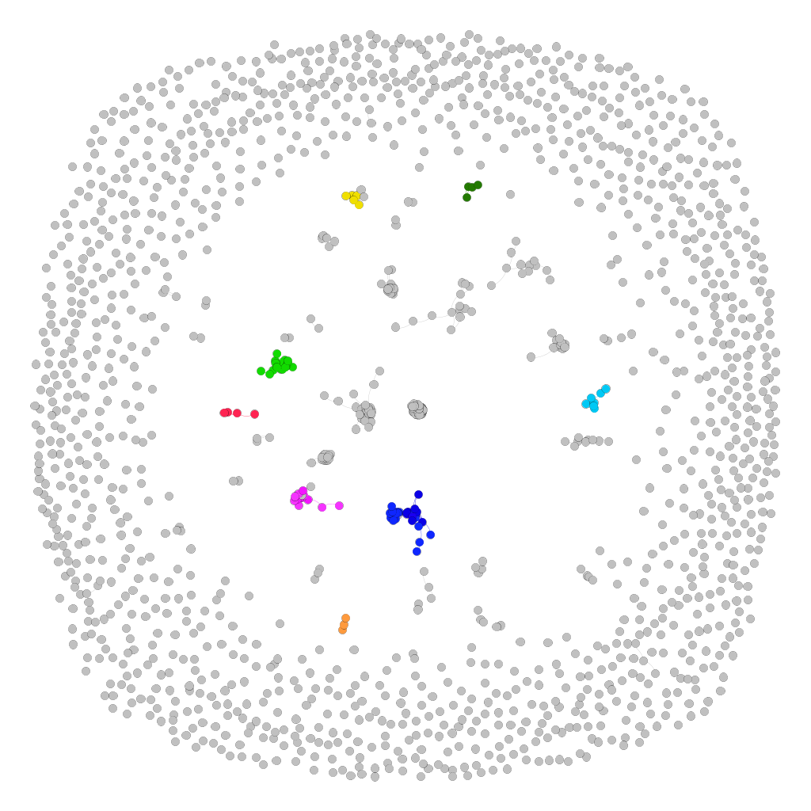
 | Cluster 1
 | Cluster 2
 | Cluster 3
 | Cluster 4
 | Cluster 7
 | Cluster 11
 | Cluster 13
 | Cluster 31

